Slide 2
OBJECTIVE

Slide 3
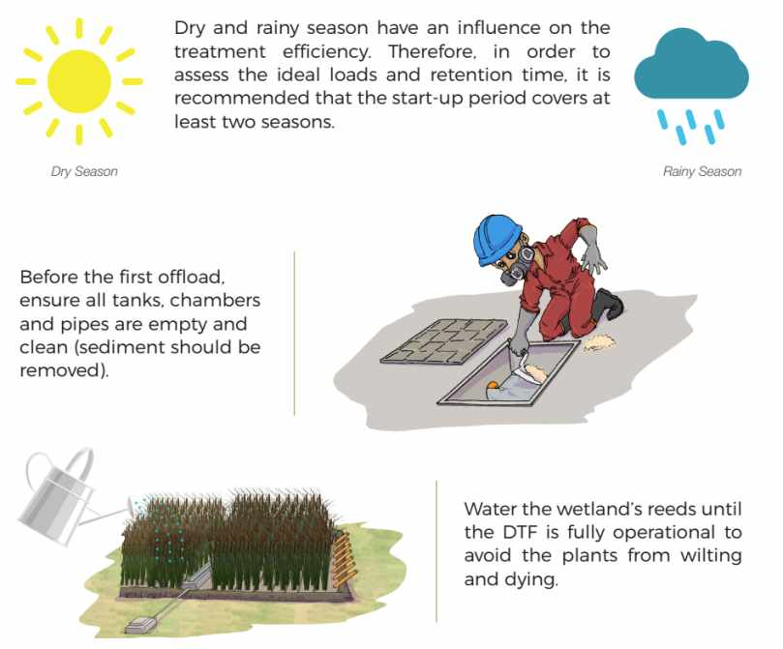
CONDITIONS

Slide 4
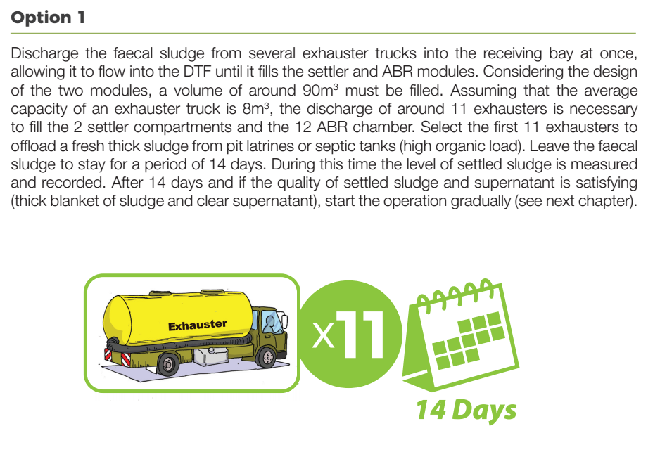
INNOCULATION PROCESS

Slide 6
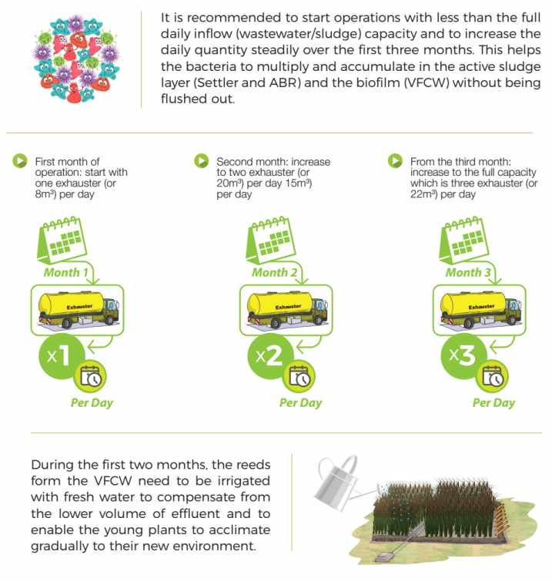
GRADUAL INFLOW

Slide 7
MONITORING

